Slide 1


RELIEF OF ACCOUNTABILITY

Slide 2


Step 1
The Accountable Officer will prepare notice of loss to Schools Division Superintendent thru Division Office Supply Officer and COA Auditor immediately or within 24 hours after the discovery of loss.
  In case of delay in the filing of the aforesaid notice and request, satisfactory explanation or the reason(s) for such delay should be submitted.
  If the occurrence of the loss has also been reported to other police agencies like the NBI, CIS, etc., the process/initial investigation report thereon should be submitted
2

Slide 3
Step 2

Slide 4
Documents Needed
The Accountable Officer will secure an Affidavit or Sworn statement of the proper accountable officer stating the following facts:
  Property loss and its evaluation
  Actual date in which the absence was first noted
  Manner of loss
  Efforts put forth to recover the same
  Provision made to safeguard the property
  Date when the loss was reported to the auditor and the police authorities
2

Slide 5
Documents Needed
2. Affidavit of two (2) disinterested persons who have personal knowledge of such fact/loss.
2

Slide 6
Documents Needed
3. The School Property Custodian will prepare Report of Lost, Stolen, Damaged or Destroyed Semi-expendable Property (RLSDDSP) supported with a copy of Inventory Custodian Slip (ICS).
2

Slide 7
Documents Needed
4. The Accountable Officer will submit the RLSDDSP supported with a copy of Inventory Custodian Slip (ICS) to accounting office for the computation of exact or accurate amount of book value of the property subject of the request of relief. Then, the accounting will issue a certification on book value of property.
2

Slide 8
Documents Needed
The Accountable Officer will submit the following to the Schools Division Superintendent through the Division Supply Office:
  Notice of loss supported with 1.1 and 1.2
  Affidavit or Sworn Statement of the proper accountable officer
  Affidavit of two (2) disinterested persons who have personal knowledge of such fact/loss.
  Report of Lost, Stolen, Damaged or Destroyed Semi-expendable Property (RLSDDSP)
  Certification on book value of property
  Other necessary documents as to incidents/occurrence stated in COA Memorandum No. 92-751 dated February 24, 1992.
2

Slide 9
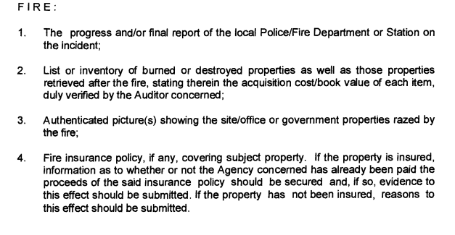
Other necessary documents:
2

Slide 10
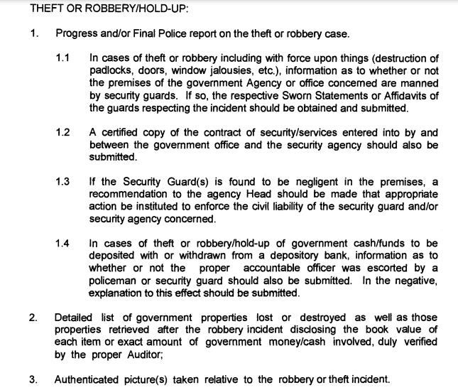
Other necessary documents:
2

Slide 11
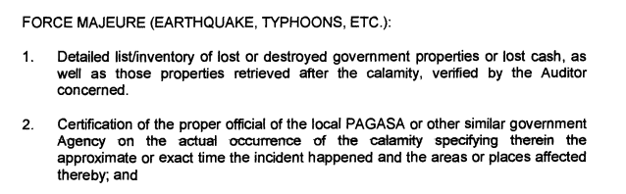
Other necessary documents:
2

Slide 12

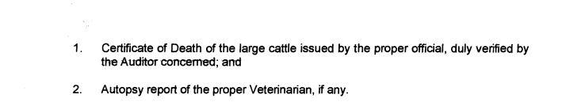
Other necessary documents:
2

Slide 13
Step 3
The Division Supply Officer will forward the documents to the SDS Office for advice or comment on the request of relief.
2

Slide 14
Step 4
The Head of Administrative Office through the Supply Office will prepare a letter to the COA Auditor for the request of relief of accountability noted by the Schools Division Superintendent.
2

Slide 15
Step 5
The Supply Office will forward the request of relief of accountability with necessary documents to the COA Auditor for approval.
2

Slide 16
Reminder:
Application for relief of accountability should be filed by the accountable officer of the school WITHIN a reglementary period of THIRTY (30) DAYS from discovery or occurrence of the loss.
2

